Slide 1
Transforming waste management with transfer learning
Team ID: LTVIP2025TMID39411
Team leader: S S Jayapriya
Team members:
1.Rampalle Vishnu Vardhan
2.Ravilla Rupachowdary
3.Revanth

Slide 2
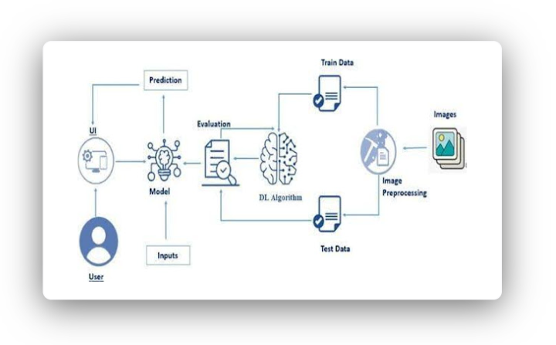
Architecture:

Slide 3
prior knowledge:
Transforming waste management using transfer learning is an emerging interdisciplinary field that liverages pre-trained machine learning models to improve waste detection,classification,sorting and monitoring,often limited la
belled data.
1.Understanding transfer learning;
Transfer learning is a machine learning technique where a model developed for one task is reused as the starting point for a model on a second,related task.
You have limited labelled data for ur target task(eg;waste classification)
You can leverage pre-trained models on large data sets like imaginate,coco,etc.
Common techniques;
*Feature extraction
*Fine-tuning
2.Waste management context;
Waste detection: recognizing waste in images or videos
Waste classification: sorting into categories
Monitoring: tracking waste levels in bins or landfill

Slide 4
Project flow;
1. Problem Definition & Objective Setting
Transforming Waste Management with Transfer Learning
tify key challenges in current waste management systems (e.g., manual sorting inefficiency, contamination).
Define project goals: e.g., automate waste classification, reduce landfill input, improve recycling accuracy using transfer learning.
2. Data Collection & Preparation
Data Sources:
Image datasets of waste (e.g., from smart bins, surveillance, public datasets like TrashNet).
Sensor data (e.g., weight, moisture, RFID).
Textual labels or metadata if using multi-modal learning.
Data Annotation:
Label waste categories (e.g., organic, recyclable, hazardous).
Ensure diversity (different lighting, angles, backgrounds).
3. Model Selection & Transfer Learning Setup
Choose a Pre-trained Model:
For images: ResNet, MobileNet, EfficientNet, VGG.
.

Slide 5
3.Applications of transfer learning ;
Task | Transfer learning application | Common models used
Waste image classification | Classify waste types using pre-trained CNNs. | Mobilenet,resnet,VGG,efficientnet
Object detection in images | Detect and locate waste types in street or bin images | YOLO,SSD,Faster R-CNNS
Sematic segmentation | Pixel-level classification of waste | U-Net,deeplock,segnetRor
Robotic waste sorting | Combine vision models with robotic acduators | Transfer learning+control systems
Smart bins | Detecet fill level and type of waste | Pre-trained vision models+IoT

Slide 6
🎯 Project Objectives: Transforming Waste Management with Transfer Learning
Leverage Pre-trained Models for Waste Classification
Utilize pre-trained deep learning models (e.g., ResNet, EfficientNet, BERT for text-based data) to classify different waste types (e.g., plastic, organic, glass, metal) from images or sensor data.
Reduce training time and data requirements by fine-tuning models on domain-specific waste datasets.
Improve Accuracy and Efficiency in Waste Sorting
Apply transfer learning to enhance automated waste sorting systems, increasing classification accuracy and speed in real-world conditions (e.g., varied lighting, occlusions, mixed waste types).
Address Data Scarcity in Waste Management
Mitigate the challenge of limited labeled datasets in waste management by transferring knowledge from general-purpose datasets (e.g., ImageNet, COCO) to smaller, domain-specific datasets.

Slide 7
Project structure;
Cwaste-management-transfer-learning/
├── README.md
├── requirements.txt
├── .gitignore
│
├── data/
│ ├── raw/ # Unprocessed waste image/text/sensor data
│ ├── processed/ # Cleaned and preprocessed data
│
│ └── annotations/ # Labeled data (e.g., bounding boxes, categories)
│
├── notebooks/
│ ├── 01_data_exploration.ipynb
│ ├── 02_preprocessing.ipynb
│ ├── 03_model_training.ipynb
│ └── 04_evaluation_visualization.ipynb
reate the project folder which contains files as shown in below

Slide 8
src/
│ ├── __init__.py
│ ├── data_loader.py # Data loading and augmentation functions
│ ├── preprocess.py # Image/text preprocessing logic
│ ├── model.py # Transfer learning model architecture
│ ├── train.py # Training loop
│ ├── evaluate.py # Evaluation functions and metrics
│ └── utils.py # Helper functions
│
├── models/
│ ├── checkpoints/ # Saved model checkpoints during training
│ └── best_model.pth # Final or best-performing model
src/
│ ├── __init__.py
│ ├── data_loader.py # Data loading and augmentation functions
│ ├── preprocess.py # Image/text preprocessing logic
│ ├── model.py # Transfer learning model architecture
│ ├── train.py # Training loop
│ ├── evaluate.py # Evaluation functions and metrics
│ └── utils.py # Helper functions
│
├── models/
│ ├── checkpoints/ # Saved model checkpoints during training
│ └── best_model.pth # Final or best-performing

Slide 9
Data collection and preparation;
ML depends heavily on data it is the most crucial aspect that makes algorithm training possible.so,this section allows you to download the required dataset.
Collect the dataset
There are manypopular open sources for collecting the data.eg:Kaggle.com,UCI repository,etc.
In this project,we have used 3 classes of biodegradable, recyclable and trash images data. This data is downloaded from Kaggle.com or can be connected by using API.please refer to the link given below to download the dataset.
Link:dataset
As the dataset is download.let us read and understand the data properly with the help pf some visualization techniques and some analyzing techniques.
Note:there are several techniques for understanding the data.but here we have used some of it.in an additional way, you can use multiple techniques.
Activity1.1:Importing the libraries
Import the necessary libraries as shown in the image.

Slide 10
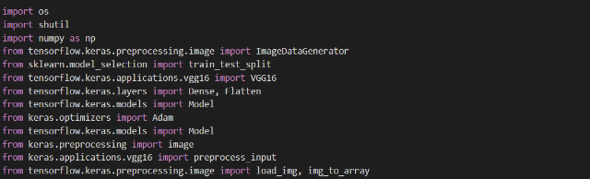
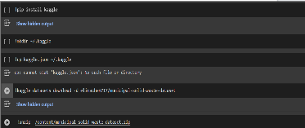
ACTIVITY 1.2:Read the dataset
…

Slide 11
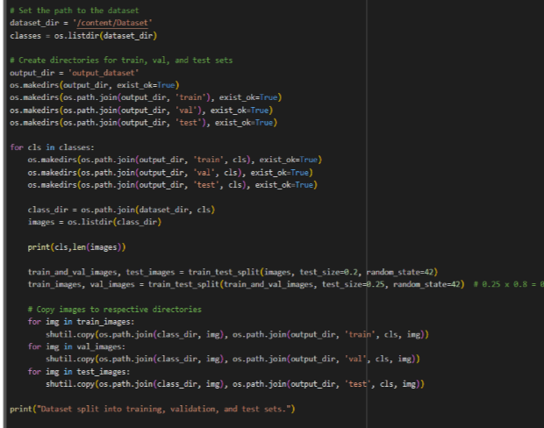
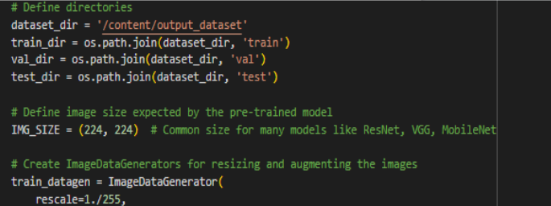

Slide 12
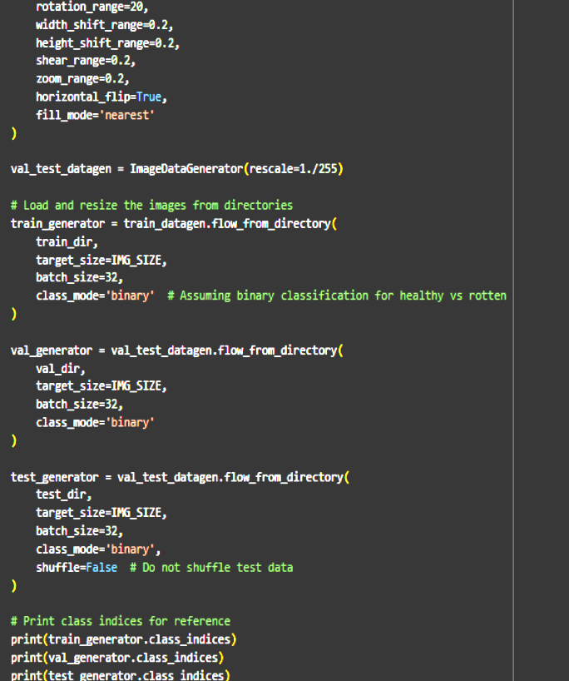

Slide 13
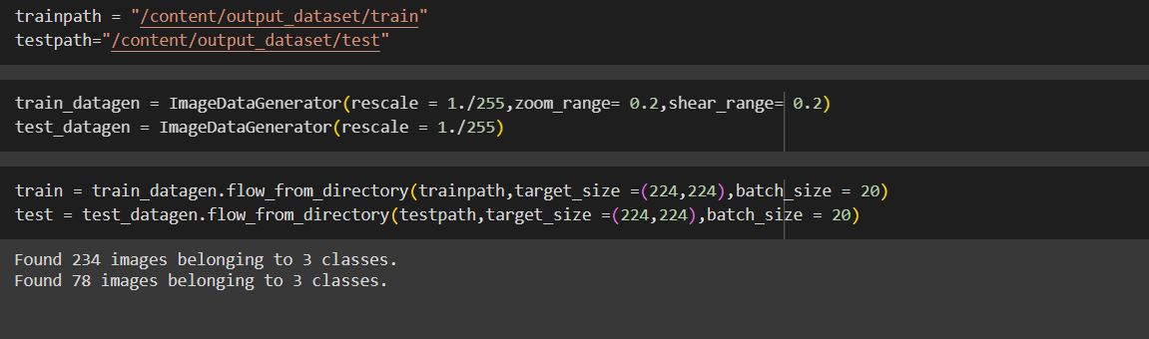
Split data and model building
Train-Test-Split:
In this project, we have already separated data for training and testing.
Train-Test-Split:
In this project, we have already separated data for training and testing.

Slide 14
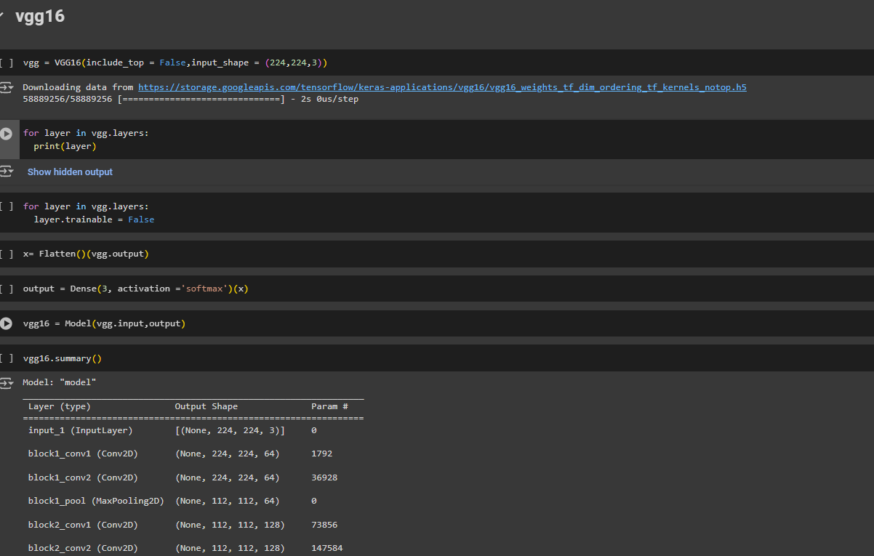
.
Model building;
Vgg16 Transfer-Learning Model:
The VGG16-based neural network is created using a pre-trained VGG16 architecture with frozen weights. The model is built sequentially, incorporating the VGG16 base, a flattening layer, dropout for regularization, and a dense layer with SoftMax activation for classification into five categories. The model is compiled using the Adam optimizer and sparse categorical cross-entropy loss. During training, which spans 10 epochs, a generator is employed for the training data, and validation is conducted, incorporating call-backs such as Model Checkpoint and Early Stopping. The best-performing model is saved as "healthy_vs_rotten.h5 " for potential future use. The model summary provides an overview of the architecture, showcasing the layers and parameters involved.

Slide 15
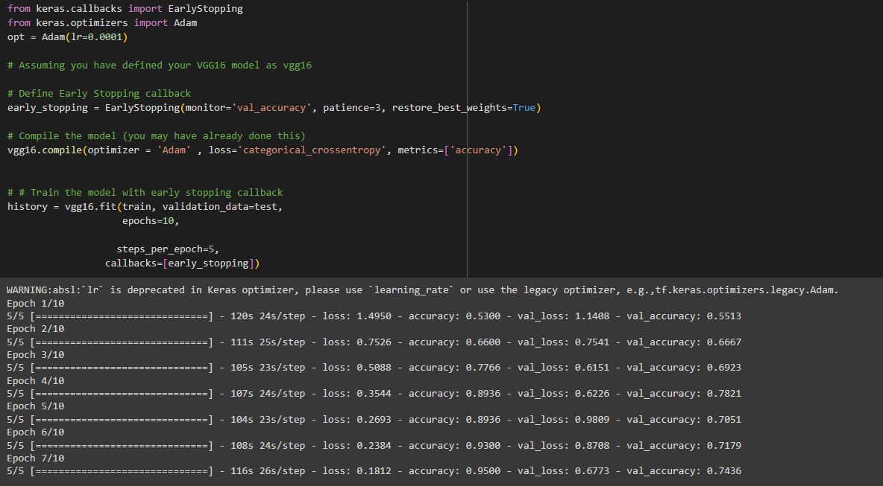

Slide 16
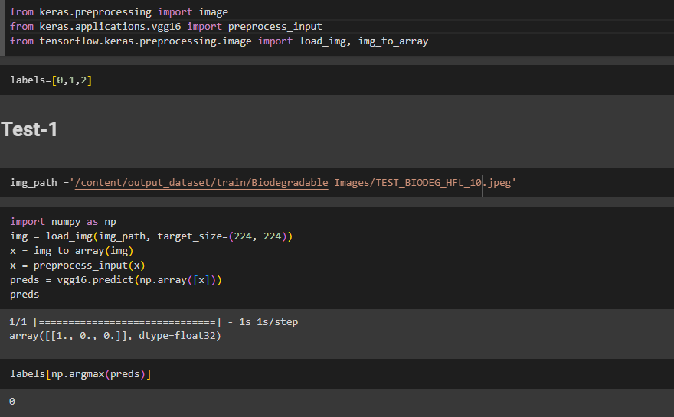
Testing Model & Data Prediction
Testing the model
Here we have tested with the Vgg16 Model With the help of the predict () function.

Slide 17
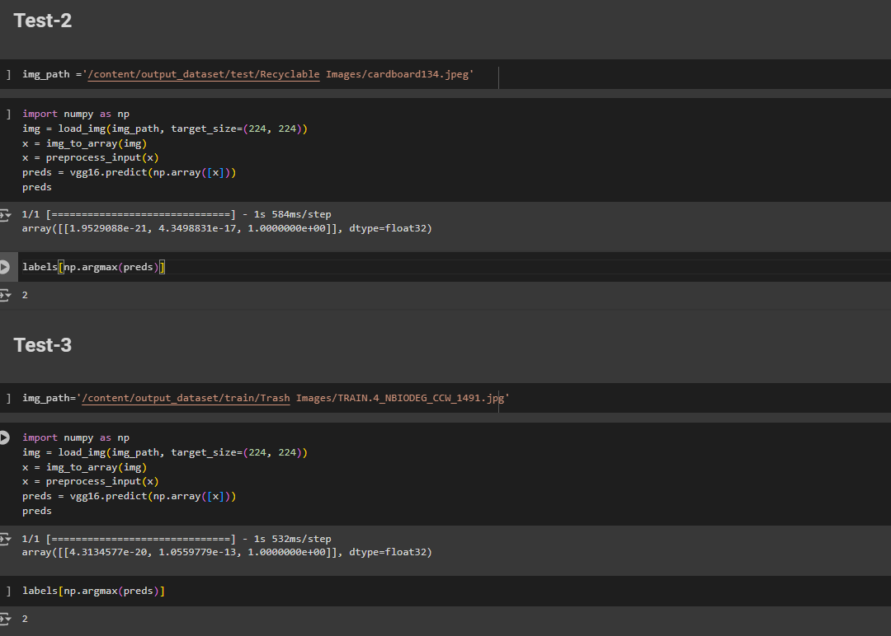

Slide 18
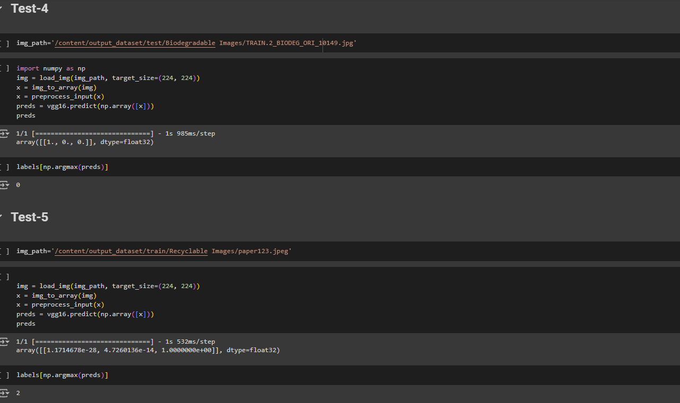

Slide 19
Saving the model
Finally, we have chosen the best model now saving that model
Application Building
In this section, we will be building a web application that is integrated into the model we built. A UI is provided for the uses where he has to enter the values for predictions. The enter values are given to the saved model and prediction is showcased on the UI.
This section has the following tasks
Building HTML Pages
Building server-side script

